Slide 1
DS8: Intermediate Machine Learning
Week 2: SVM & PCA

Slide 2
Content – week 2
Classification using Support Vector Machine (linear kernel)
Dimension reduction using Principal Components Analysis

Slide 3
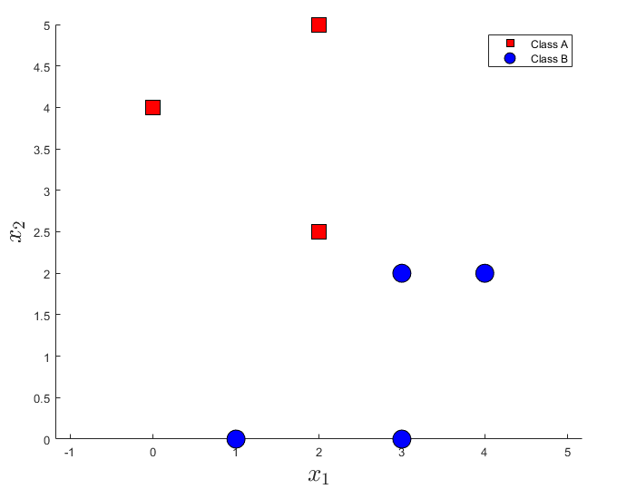
Supervised binary classification
Given a dataset of (numeric) features and binary labels, what would the best possible classifier look like?

Slide 4
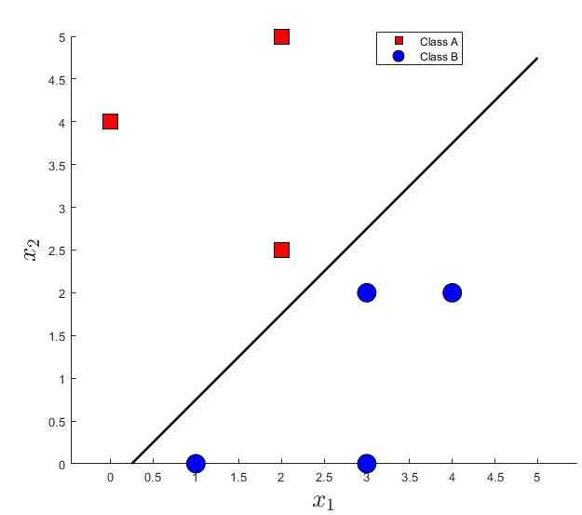
Decision boundary
The line that bisects the dataset, a 'hyperplane', is called decision boundary (or decision surface)
Which of the hyperplanes in this images divides the dataset into two 'best'?

Slide 5
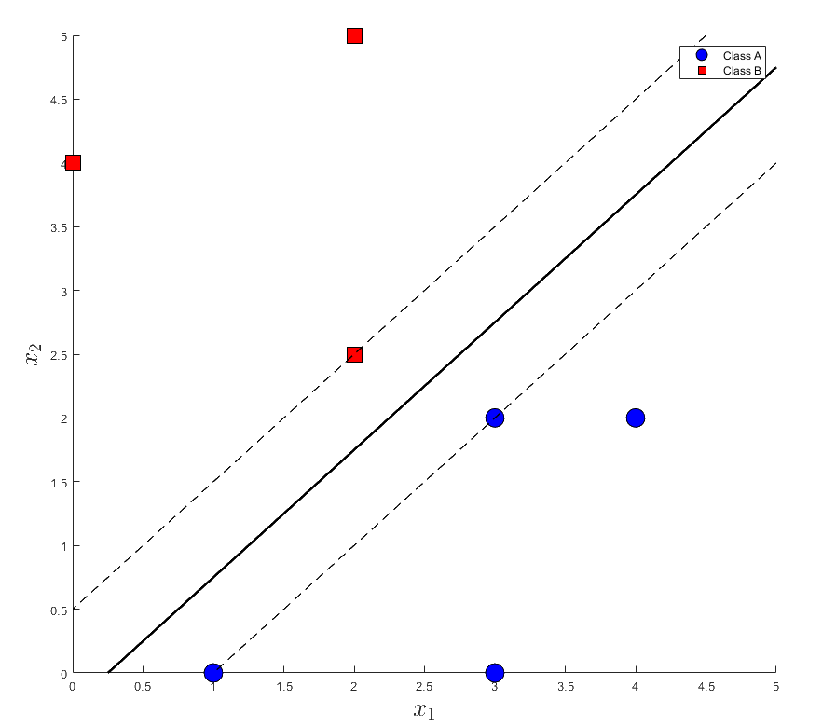
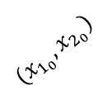
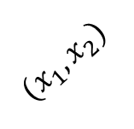

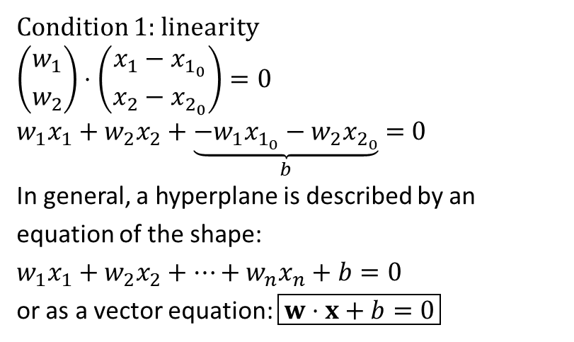
Maximal margin classifier
The line with the maximum margin, the greatest distance to the nearest points, is called the 'maximal margin hyperplane'
Condition 1: linearity
$$\left({w_{1} \atop w_{2}}\right)⋅\left({x_{1}−x_{1_{0}} \atop x_{2}−x_{2_{0}}}\right)=0$$
$$w_{1}x_{1}+w_{2}x_{2}+\underset{b}{\underbrace{−w_{1}x_{1_{0}}−w_{2}x_{2_{0}}}} =0$$
In general, a hyperplane is described by an equation of the shape: $$w_{1}x_{1}+w_{2}x_{2}+…+w_{n}x_{n}+b=0$$
or as a vector equation: $\boxed{w⋅x+b=0}$
$$w$$
$$(x_{1},x_{2})$$
$$(x_{1_{0}},x_{2_{0}})$$
For example, if this point were lower, it would not affect the location of the hyperplane.

Slide 6
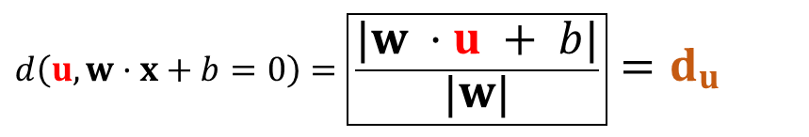
Distance to the hyperplane
$$\left(\begin{matrix}u_{1} \\ u_{2}\end{matrix}\right)$$
$$w$$
$$d\left(u,w·x+b=0\right)=\boxed{\frac{|w ·u + b|}{\left|w\right|}}=d_{u}$$
$$(x_{1_{0}},x_{2_{0}})$$

Slide 7


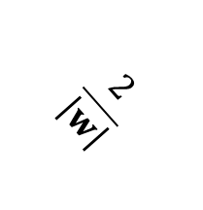
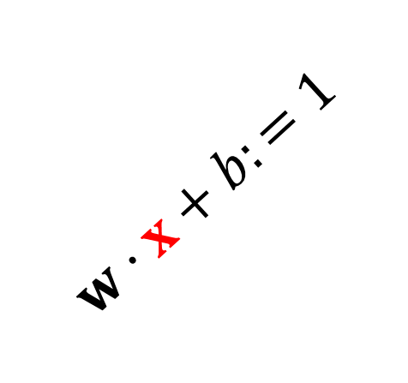
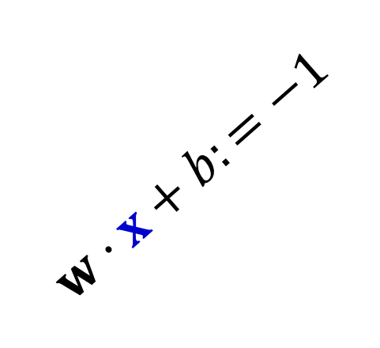
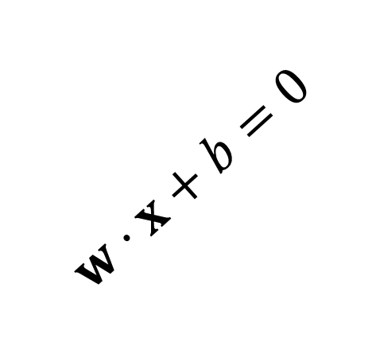

Support vectors
Support vectors: points (vectors) that lie (exactly) on the curbs of the street, in the example there are three of them.
$$\frac{2}{\left|w\right|}$$
hyperplane
$$w$$
$$w·x+b:=1$$
$$d\left(x_{k},w·x+b=0\right)=\frac{|w·x_{k}+b|}{|w|}=\frac{1}{|w|}$$
$$w·x+b=0$$
$streetwidth=\frac{2}{\left|w\right|}$
$$w·x+b:=−1$$

Slide 8

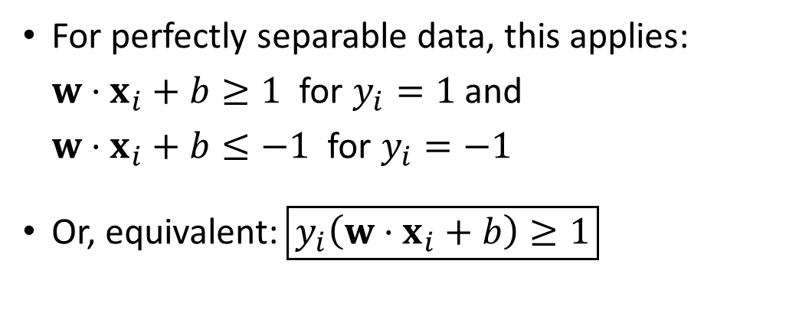

Condition 2
$$y_{i}=1$$
For perfectly separable data, this applies: $w·x_{i}+b≥1$ for $y_{i}=1$ and $w·x_{i}+b≤−1$ for $y_{i}=−1$
Or, equivalent:$\boxed{y_{i}\left(w·x_{i}+b\right)≥1}$
$$w·x+b=1$$
$$w·x+b=0$$
$$y_{i}=−1$$
$$w·x+b=−1$$

Slide 9
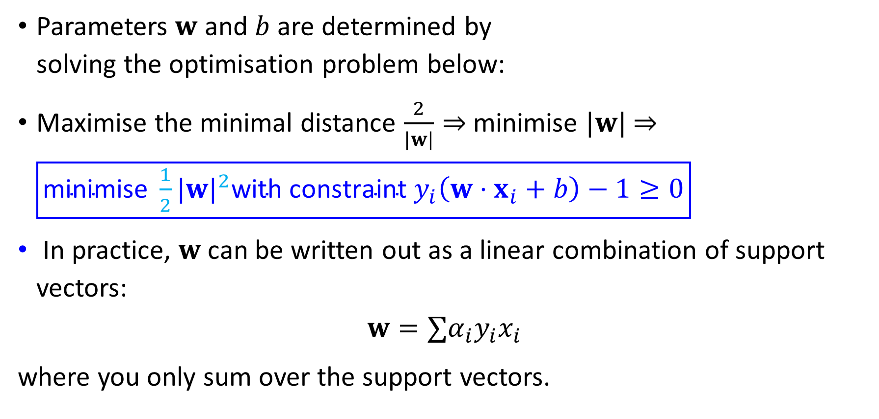
Optimisation problem
Parameters $w$ and $b$ are determined by solving the optimisation problem below:
Maximise the minimal distance $\frac{2}{|w|}⇒$minimise $|w|$ $⇒$ $\boxed{\text{minimise} {\frac{1}{2}|w|}^{2}\text{with} \text{constraint} y_{i}\left(w⋅x_{i}+b\right)−1≥0}$
In practice, $w$ can be written out as a linear combination of support vectors:
$$w=∑α_{i}y_{i}x_{i}$$
where you only sum over the support vectors.

Slide 10
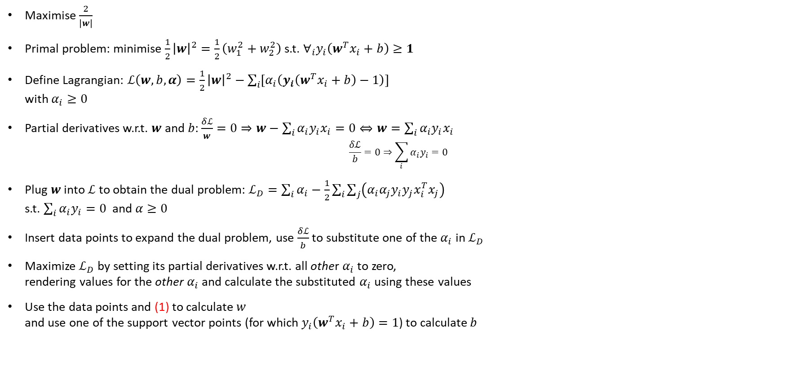
Optimisation problem - Lagrange
Maximise $\frac{2}{\left|w\right|}$
Primal problem: minimise $\frac{1}{2}{\left|w\right|}^{2}=\frac{1}{2}\left(w_{1}^{2}+w_{2}^{2}\right)$ s.t. $∀_{i}y_{i}\left(w^{T}x_{i}+b\right)≥1$
Define Lagrangian: $ℒ\left(w, b, α\right)=\frac{1}{2}{\left|w\right|}^{2}−\sum_{i}{\left[α_{i}\left(y_{i}\left(w^{T}x_{i}+b\right)−1\right)\right]}$ with $α_{i}≥0$
Partial derivatives w.r.t. $w$ and $b$: $\frac{δℒ}{w}=0⇒w−\sum_{i}{α_{i}y_{i}x_{i}}=0⇔w=\sum_{i}{α_{i}y_{i}x_{i}}$ $\frac{δℒ}{b}=0⇒\sum_{i}{α_{i}y_{i}=0}$
Plug $w$ into $ℒ$ to obtain the dual problem: $ℒ_{D}=\sum_{i}{α_{i}}−\frac{1}{2}\sum_{i}{\sum_{j}{\left(α_{i}α_{j}y_{i}y_{j}x_{i}^{T}x_{j}\right)}}$ s.t. $\sum_{i}{α_{i}y_{i}=0}$ and $α≥0$
Insert data points to expand the dual problem, use $\frac{δℒ}{b}$ to substitute one of the $α_{i}$ in $ℒ_{D}$
Maximize $ℒ_{D}$ by setting its partial derivatives w.r.t. all other $α_{i}$ to zero, rendering values for the other $α_{i}$ and calculate the substituted $α_{i}$ using these values
Use the data points and (1) to calculate $w$ and use one of the support vector points (for which $y_{i}\left(w^{T}x_{i}+b\right)=1$) to calculate $b$
(1)

Slide 11
Optimisation problem - Lagrange
Backup plan: use a computer to find the definition of the separating hyperplane!

Slide 12
What if we cannot separate linearly?

Slide 13
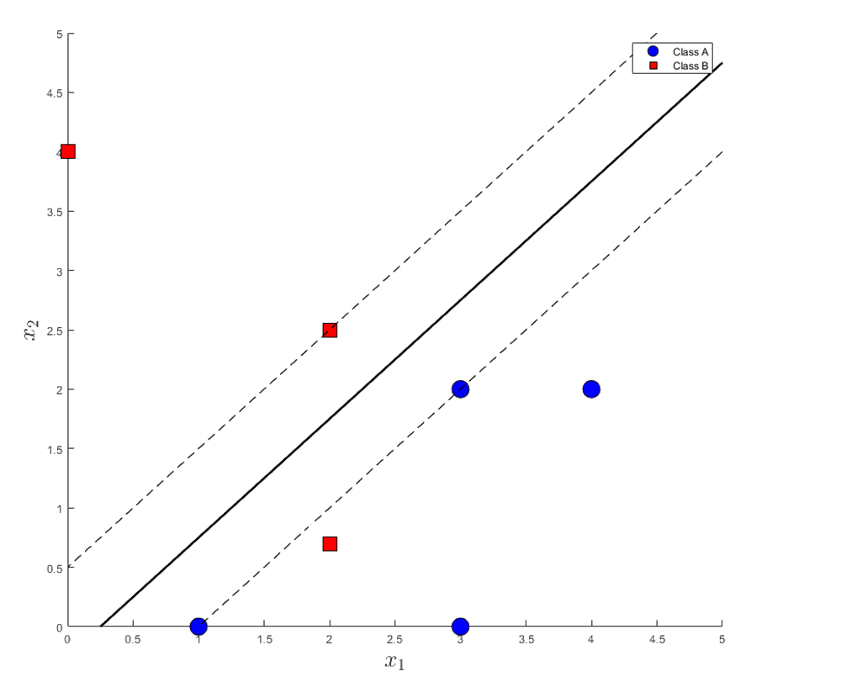
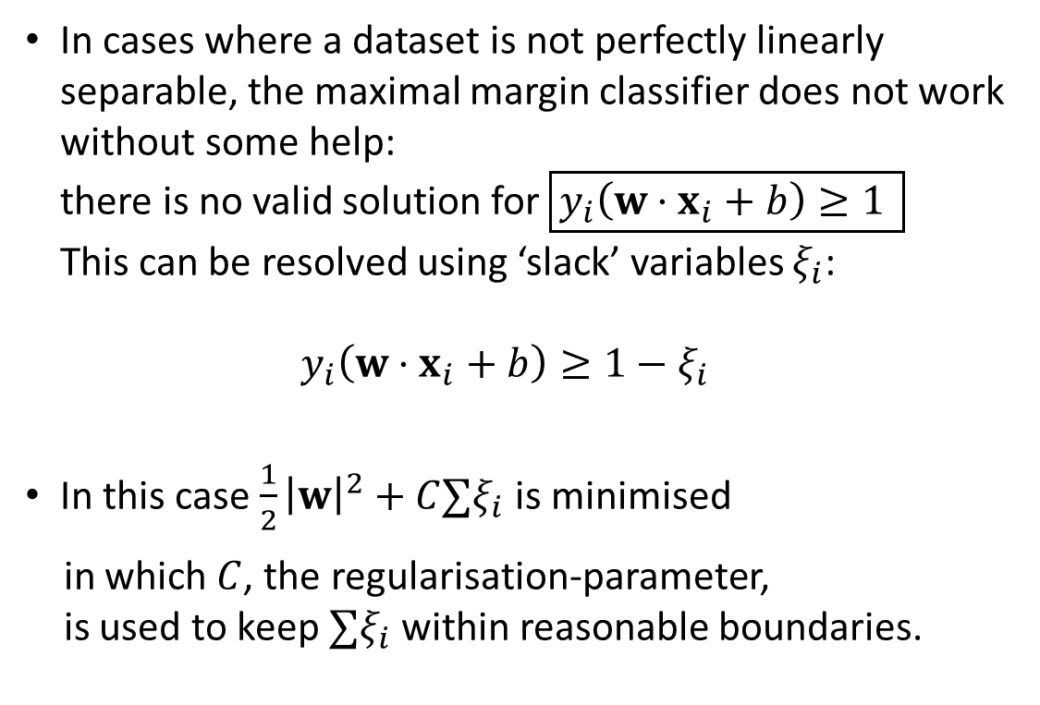
Solution 1 for the problem of not linearly separable data: slack
In cases where a dataset is not perfectly linearly separable, the maximal margin classifier does not work without some help: there is no valid solution for$\boxed{y_{i}\left({w·x}_{i}+b\right)≥1 }$ This can be resolved using ‘slack’ variables $ξ_{i}$: $y_{i}\left(w·x_{i}+b\right)≥1−ξ_{i}$
In this case $\frac{1}{2}{\left|w\right|}^{2}+C∑ξ_{i}$ is minimised
in which $C$, the regularisation-parameter, is used to keep $∑ξ_{i}$ within reasonable boundaries.
Notes:
blz. 419 Eslii

Slide 14
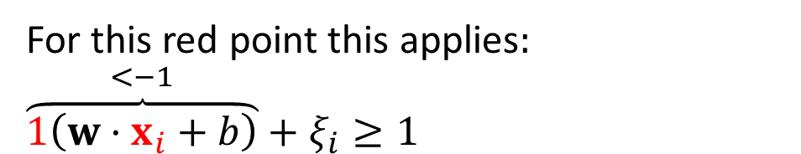

Solution 1 for the problem of not linearly separable data: slack
perfectly linearly separable → $ξ_{i}→0, C→\sim ∞$
not linearly separable $ξ_{i}→\sim ∞, C→0$
For this red point this applies
Notes:
blz. 419 Eslii

Slide 15
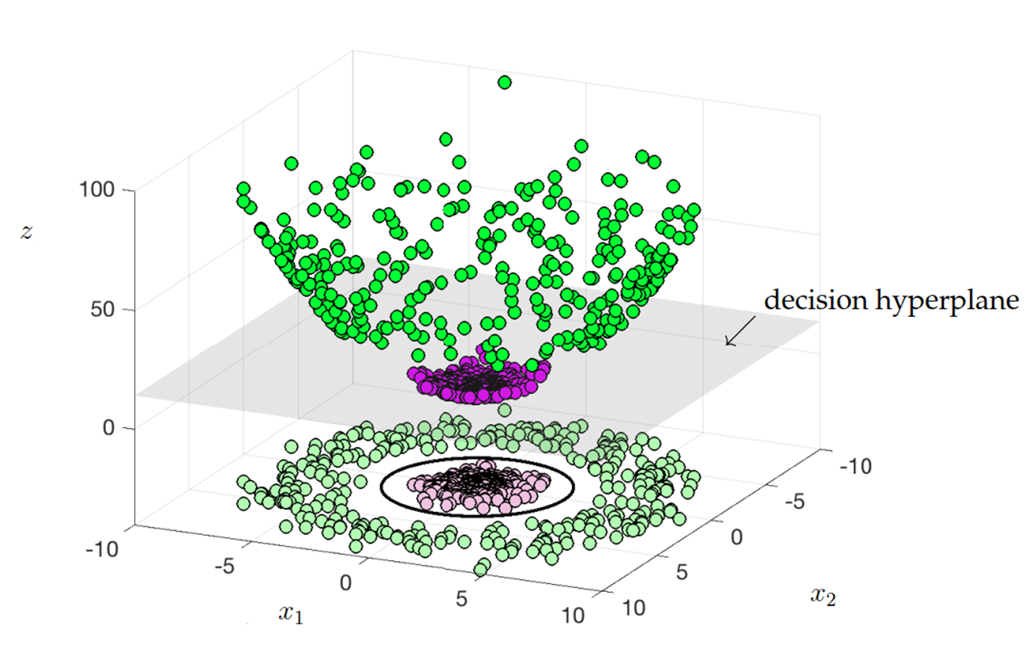
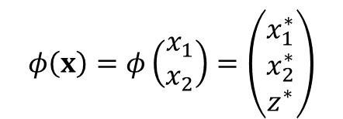
Solution 2 for not linearly separable data: transform to a higher dimension
$$φ\left(x\right)=φ\left(\begin{matrix}x_{1} \\ x_{2}\end{matrix}\right)=\left(\begin{matrix}x_{1}^{∗} \\ x_{2}^{∗} \\ z^{∗}\end{matrix}\right)$$

Slide 16
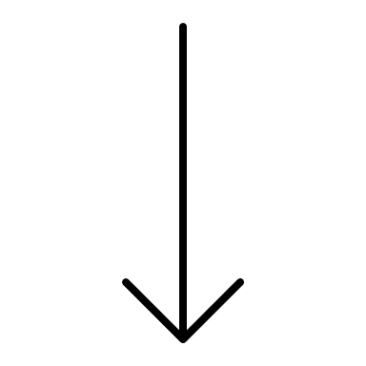

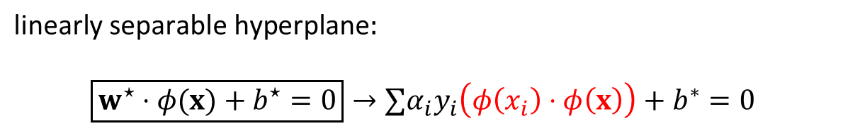
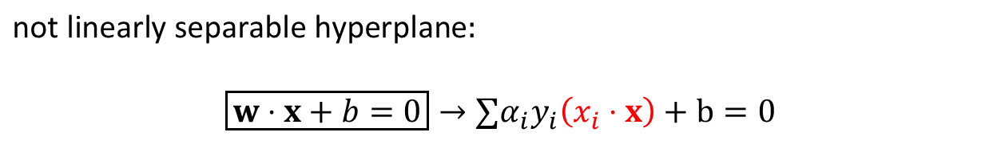
Function $φ$
keep this in mind
$$\text{not} \text{linearly} \text{separable} \text{hyperplane}:$$
$$\boxed{w⋅x+b=0}→∑α_{i}y_{i}\left(x_{i}⋅x\right)+b=0$$
Calculating inproduct is an 'expensive' operation for a computer
$$\text{linearly} \text{separable} \text{hyperplane}:$$
$\boxed{w^{⋆}⋅φ(x)+b^{⋆}=0}→∑α_{i}y_{i}\left(φ\left(x_{i}\right)⋅φ\left(x\right)\right)+b^{∗}=0$
This is (obviously) even more expensive. The solution to our problem is on the next slide

Slide 17
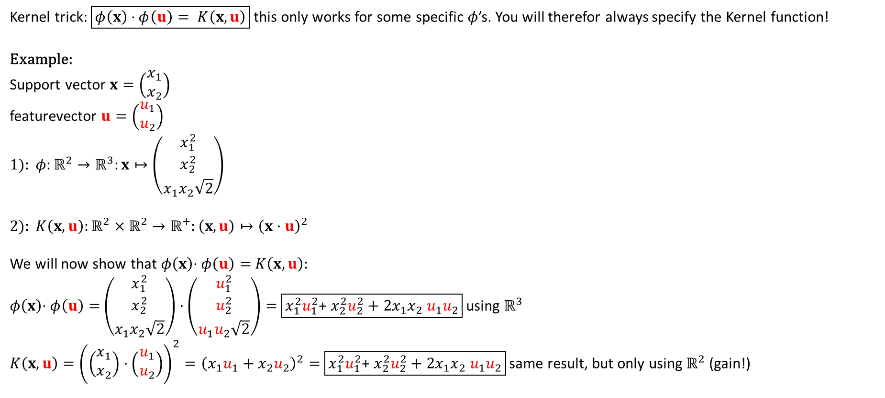
Kernel trick (bypassing computation in the higher dimension, as this is far too expensive computationally for large datasets)
Kernel trick: $\boxed{φ\left(x\right)\text{ ·} φ\left(u\right)= K\left(x,u\right)}$ this only works for some specific $φ$’s. You will therefor always specify the Kernel function!
Example:
Support vector $x=\left(\begin{matrix}x_{1} \\ x_{2}\end{matrix}\right)$
featurevector $u=\left(\begin{matrix}u_{1} \\ u_{2}\end{matrix}\right)$
$$1): φ:ℝ^{2}→ℝ^{3}:x↦\left(\begin{matrix}x_{1}^{2} \\ x_{2}^{2} \\ x_{1}x_{2}\sqrt{2}\end{matrix}\right)$$
$$2): K\left(x,u\right):ℝ^{2}×ℝ^{2}→ℝ^{+}:\left(x,u\right)↦{\left(x·u\right)}^{2}$$
We will now show that $φ\left(x\right)$· $φ\left(u\right)=$ $K\left(x,u\right):$
$φ\left(x\right)$· $φ\left(u\right)=$ $\left(\begin{matrix}x_{1}^{2} \\ x_{2}^{2} \\ x_{1}x_{2}\sqrt{2}\end{matrix}\right)·\left(\begin{matrix}u_{1}^{2} \\ u_{2}^{2} \\ u_{1}u_{2}\sqrt{2}\end{matrix}\right)=$ $\boxed{x_{1}^{2}u_{1}^{2}\text{+} x_{2}^{2}u_{2}^{2}+2x_{1}x_{2} u_{1}u_{2}}$ using $ℝ^{3}$ $K\left(x,u\right)={\left(\left(\begin{matrix}x_{1} \\ x_{2}\end{matrix}\right)·\left(\begin{matrix}u_{1} \\ u_{2}\end{matrix}\right)\right)}^{2}={\left(x_{1}u_{1}+x_{2}u_{2}\right)}^{2}=$ $\boxed{x_{1}^{2}u_{1}^{2}\text{+} x_{2}^{2}u_{2}^{2}+2x_{1}x_{2} u_{1}u_{2}}$ same result, but only using $ℝ^{2}$ (gain!)

Slide 18

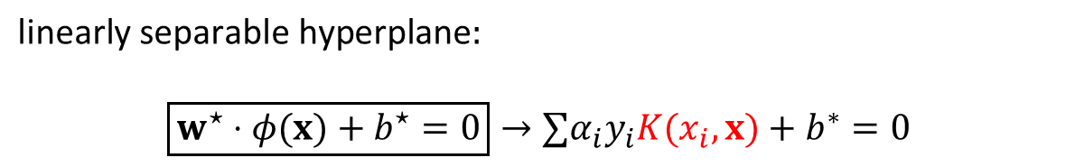
Kernel function $K$
keep this in mind
$$\text{not} \text{linearly} \text{separable} \text{hyperplane}:$$
$$\boxed{w⋅x+b=0}→∑α_{i}y_{i}\left(x_{i}⋅x\right)+b=0$$
Calculating inproduct is an 'expensive' operation for a computer
$$\text{linearly} \text{separable} \text{hyperplane}:$$
$\boxed{w^{⋆}⋅φ(x)+b^{⋆}=0}→∑α_{i}y_{i}K(x_{i}, x)+b^{∗}=0$
Relatively inexpensive compared to transformation. Turns out, we don’t need to calculate the transformation. We only need the dot product to be equal to ‘some kernel’.

Slide 19
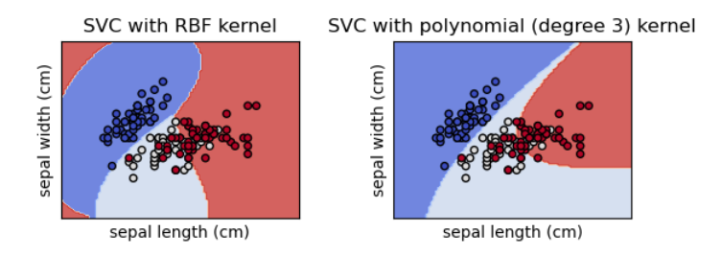
Common non linear kernels
Polynomial kernel: $K\left(x_{i},x_{j}\right)={\left(x_{i}⋅x_{j}+1\right)}^{n}$
$$\text{Radial} \text{basis} \text{function}\text{ (}\text{RBF}\text{)}: K\left(x_{i},x_{j}\right)=e^{(−γ|x_{i}−x_{j}|)}$$

Slide 20
Summary for SVM
The maximal margin/support vector classifier produces a linear decision boundary/hyperplane
Often the boundary between classes is not linear
By running a support vector classifier on a transformed version of the data, often to a higher dimension, support vector machines circumvent this problem
Because the solution to the optimisation problem ultimately uses only the inner product of the feature vectors and we can replace those inner products with a kernel function that, given two feature vectors, gives a different measure of the similarity of those vectors, we can, by varying kernel functions, still produce different, non-linear decision boundaries

Slide 21
Dimension reduction
For high-dimensional datasets (more than two or three features), visualisation is difficult. It can help to transform the high-dimensional dataset to a low-dimensional dataset for display (2d, 3d).
Dimensionality reduction is the transformation of data (i.e. not a model) from a high-dimensional space to a low-dimensional space, such that the low-dimensional representation retains some meaningful properties of the original data.
The 'Curse of Dimensionality' describes the explosive nature of increasing data dimensions and the consequent increase in computing power required to process and/or analyse them.

Slide 22
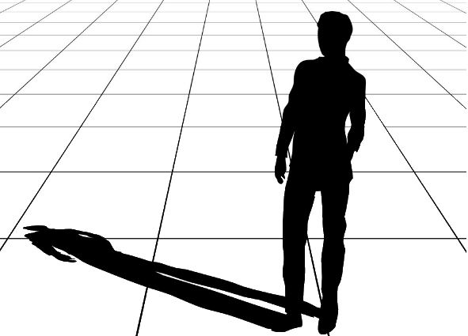
Idea of dimension reduction
$$x_{2}$$
$$x_{1}$$

Slide 23
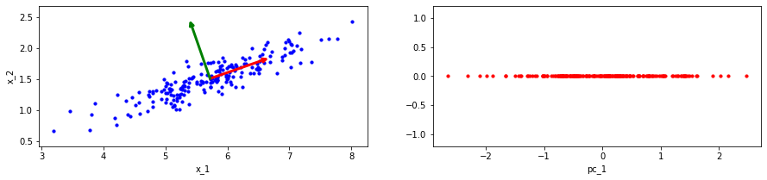
Dimension reduction
Principal Components Analysis is a widely used method for dimension reduction. The eigenvectors of the covariance matrix of the dataset yield a new 'coordinate system', and sorted descending by their corresponding eigenvalues, the 'principal components' are determined. Each of the subsequent principal components (first, second, …) maximises the variance of the transformed data over its direction.
Scikit-learn has a built-in method to transform a (high-dimensional) dataset to a specified (lower) number of dimensions: PCA(n_components=1).fit_transform(data)
dimensiereductie
$$u_{2}$$
$$u_{1}$$

Slide 24
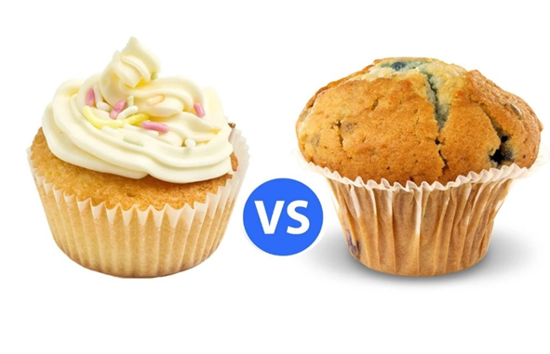
Support vector machine – examples
discern between cupcakes and muffins?

